Slide 1


Administrator
LVCT Health
Lyani Sitti – Supply Chain Specialist

Slide 2
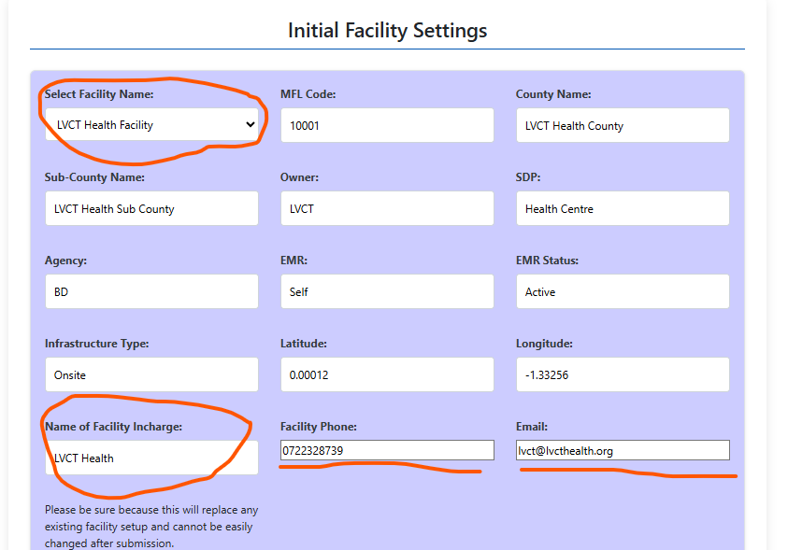
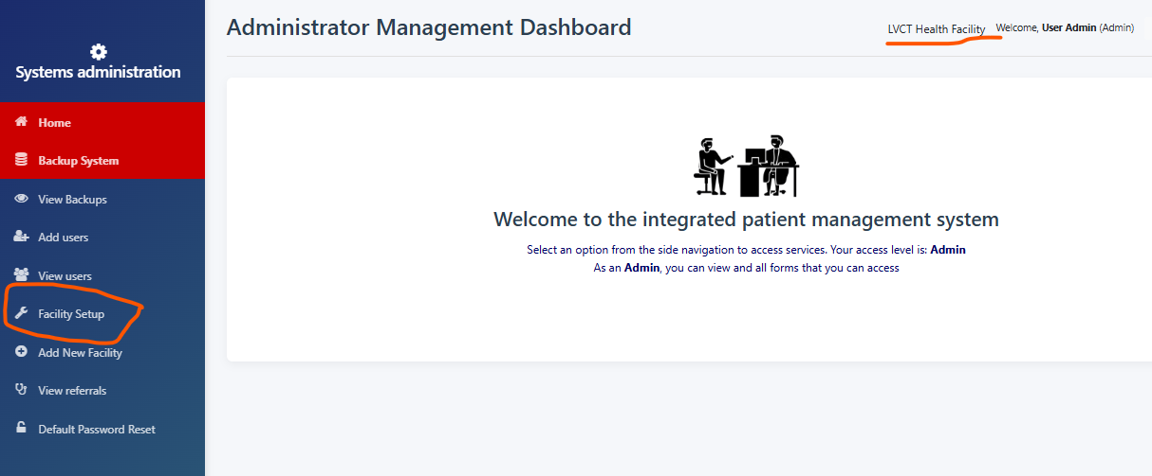
Facility setup

Slide 4
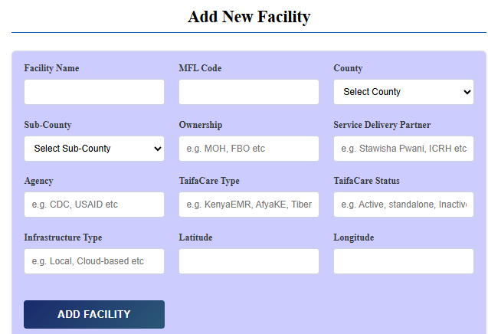
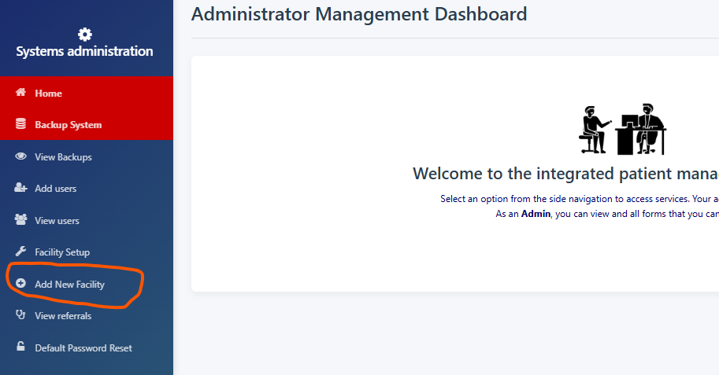
Add New Facility

Slide 5
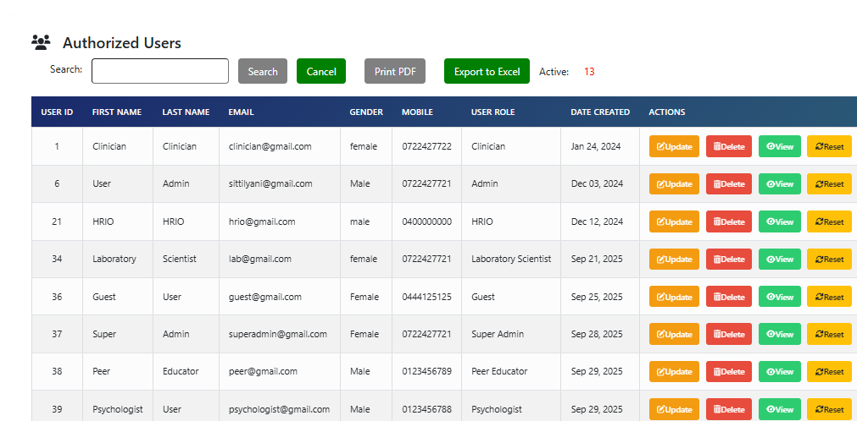
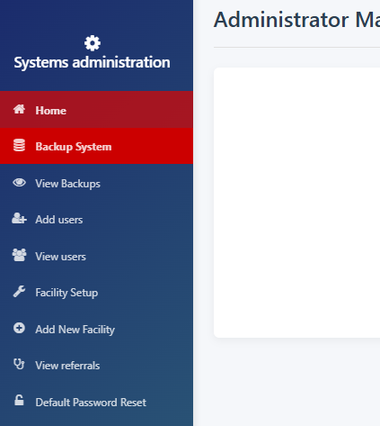
View users

Slide 6
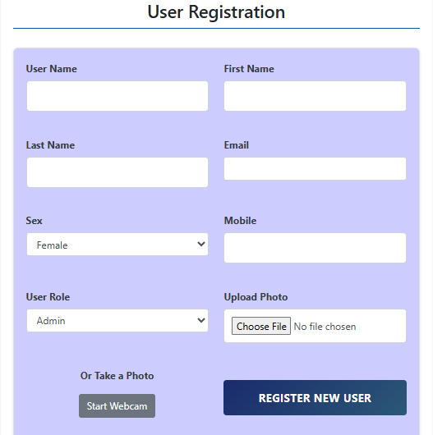
Add users

Slide 7
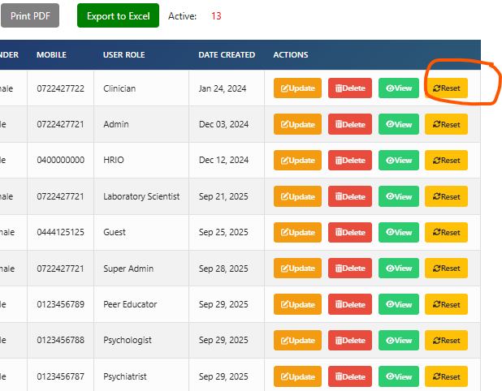
Admin password reset

Slide 8
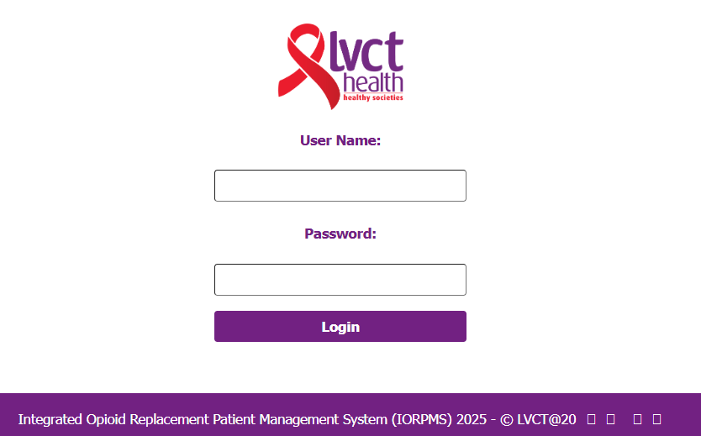
Activity 1
Login as admin
Username: admin
Password: 123456

Slide 9
Create user
Choose your username, and enter all other details
For user role; select your user role in the MAT clinic and submit
View users and see if your user is created
Logout and login using your credentials

Slide 10
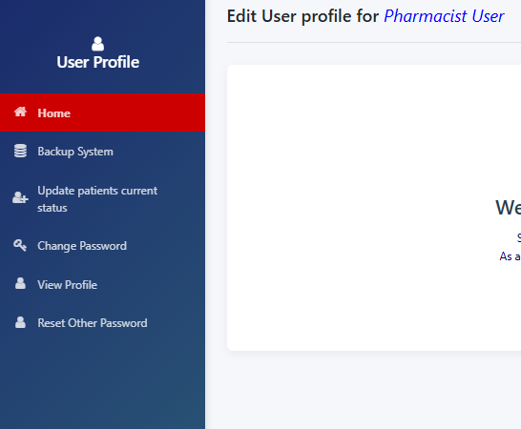
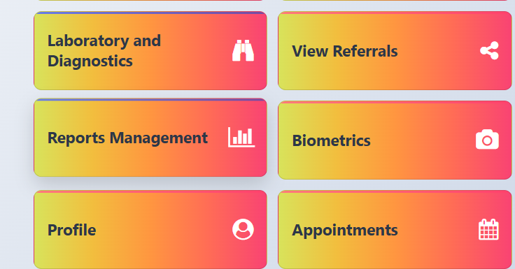
View your profile

Slide 11
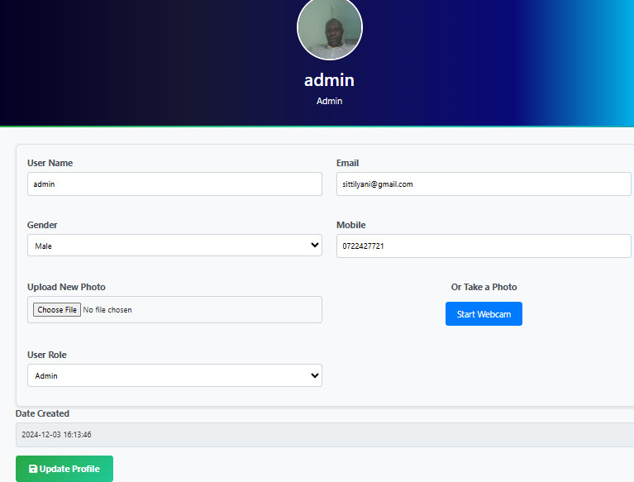
View profile

Slide 12
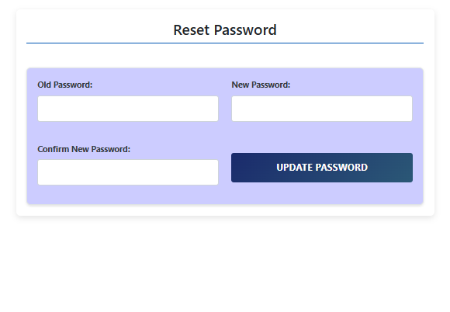
View profile

Slide 13
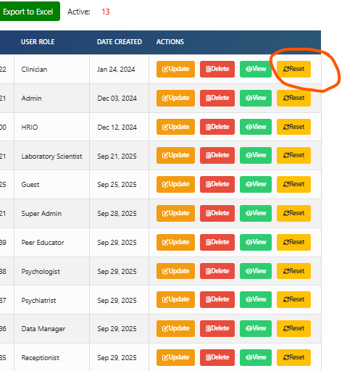
View profile

Slide 14
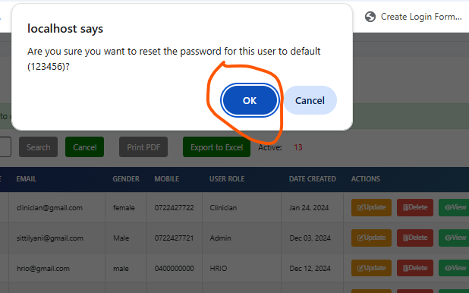
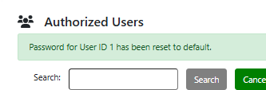
Hard reset password – ADMIN ONLY

Slide 15


THANK YOU
Contact us
www.lvcthealth.org www.lvctgroup.org www.one2onekenya.org
@LVCTKenya
@lvctKe
LVCTHealth
TheLVCT

